Slide 1
Lecture 09: Interaction and Faceting
DS 4200
Fall 2022
Prof. Ab Mosca (they/them)
Northeastern University
Slides and inspiration from Cody Dunne, Michelle Borkin, Dylan Cashman, Krzysztof Gajos, Hanspeter Pfister,
Miriah Meyer, Jonathan Schwabish, and David Sprague

Slide 2
Faceting
From Munzner’s book
Notes:
Now, let’s move into our discussion on Faceting.

Slide 3



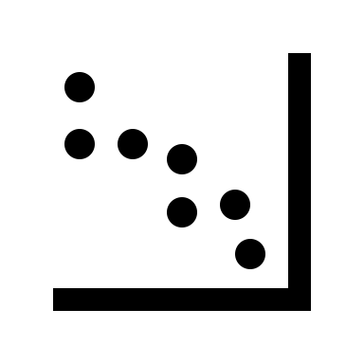
Visualizing Big Data
Notes:
One big challenge when designing visualizations is figuring out how to effectively fit large amounts of data onto a visualization shown on a small screen.
Over the years, numerous approaches to this challenge have been used <next>

Slide 4
Faceting
Facet (verb) = to split
Notes:
The word facet is a verb that means to split. <next>

Slide 5
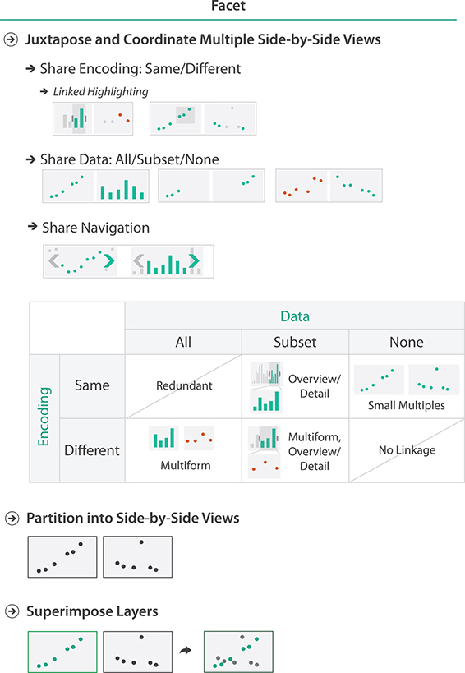
Faceting
Facet (verb) = to split
In visualization, it means:
split into multiple views
or separate into layers
Notes:
In visualization, faceting refers to splitting your visualization into multiple views or layers.
Views are splits of data that are shown side-by-side, and layers are splits of data that are shown superimposed.
<next>

Slide 6
Faceting
Facet (verb) = to split
In visualization, it means:
split into multiple views
or separate into layers
Why?
- complexity reduction
- rely on vision instead of memory retrieval
Notes:
Now why do we use faceting?
Well, for two main reasons.
It can help reduce the complexity of a visualization, and helps ensure our visualizations are relying on vision instead of memory, which you may remember is one of the design rules of thumb we talked about early in the semester.
<next>

Slide 7
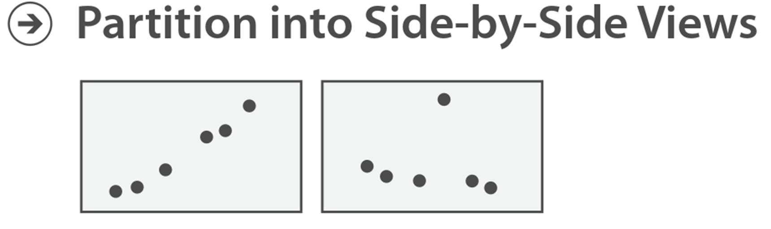
Faceting
Side-by-Side Views
Pro:
Easy to compare
Con:
→ Takes up more space on the screen
Notes:
Let’s look a bit more at side-by-side views.
Some pros to this approach are that the two views of data are easy to compare.
And a con is that this approach takes up a lot of screen space.
<next>

Slide 8
Faceting
Side-by-Side Views
Pro:
Easy to compare
Con:
→ Takes up more space on the screen
https://www.gapminder.org/
Notes:
For example, let’s go back to the gapminder example we’ve seen before.
I can facet my data so that I have side-by-side views showing data from different regions of the world.
This makes it easy to compare between these two regions, but now I need twice as much space to show my data as I would with one view.

Slide 9
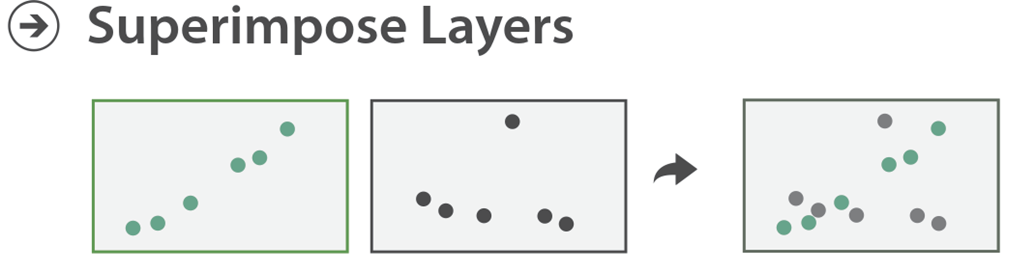
Faceting
Superimposed Layers
Pro:
Requires less screen space
Easy to compare
Con:
Limits encoding options
Can get messy
Notes:
Now, superimposed layers have the benefit of requiring less scree space, but still being easy to compare.
The downside to superimposed layers of data is that it limits your encoding options, and can get messy with many facets.
<next>

Slide 10
Faceting
Superimposed Layers
Pro:
Requires less screen space
Easy to compare
Con:
Limits encoding options
Can get messy
https://www.gapminder.org/
Notes:
For example, if I take that gapminder example again and super impose my splits of data instead of arranging them side by side you can see its still east to compare values between the two regions, but now I can do this comparison is half the amount of space.
However, if I wanted to add even more regions to this dataset, you can see how all the superimposed layers could become messy quickly.

Slide 11
Faceting
Coordination → In addition to arranging views side-by-side vs. superimposed we need to choose how to coordinate them (or not)
Notes:
Now, in addition to deciding how to arrange facets of our data, it’s also important to decide how we want to coordinate those facets.
<next>

Slide 12

Faceting
Coordination → In addition to arranging views side-by-side vs. superimposed we need to choose how to coordinate them (or not)
Notes:
The way we do this is typically by considering (1) if the views share an encoding, and (2) how much data the views share.
If we look at all possible combinations for these two factors, we get a number of different coordinated visualization techniques, shown in the table here.
Let’s take a look at each of these coordination techniques.

Slide 13
Faceting
Coordination → Multiform
Notes:
Let’s start by looking at facets that share all of their data. In this case, the facets must have different encodings, otherwise we’re looking at the same visualization twice.
When the facets share all of their data and have different encodings we call the visualization multiform.

Slide 14
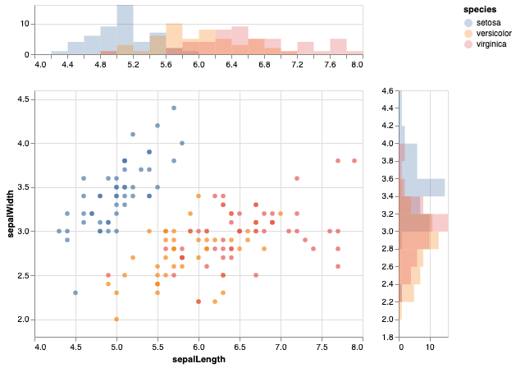
Faceting
Coordination → Multiform
https://altair-viz.github.io/gallery/scatter_marginal_hist.html
Notes:
Let’s start by looking at facets that share all of their data. In this case, the facets must have different encodings, otherwise we’re looking at the same visualization twice.
When the facets share all of their data and have different encodings we call the visualization multiform.

Slide 15
Faceting
Coordinate → Overview/Detail
Notes:
On the other hand, if our faces share some data, meaning one shows a subset of the other, then it makes sense for them to either have the same or different encodings.
If they have the same encoding, we call the visualization and overview / detail visualization. If they have different encodings we call the visualization an multiform and overview / detail visualization.
<next>

Slide 16
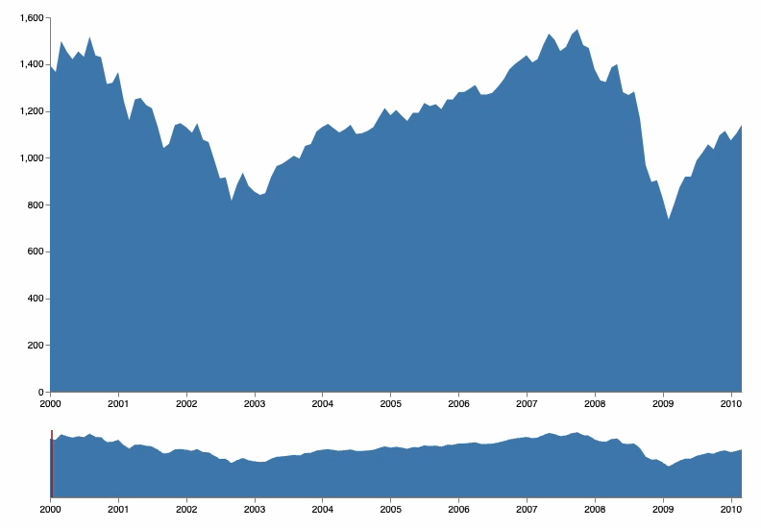
Faceting
Coordinate → Overview/Detail
https://vega.github.io/vega/examples/overview-plus-detail/
Notes:
On the other hand, if our faces share some data, meaning one shows a subset of the other, then it makes sense for them to either have the same or different encodings.
If they have the same encoding, we call the visualization and overview / detail visualization. If they have different encodings we call the visualization an multiform and overview / detail visualization.
<next>

Slide 17
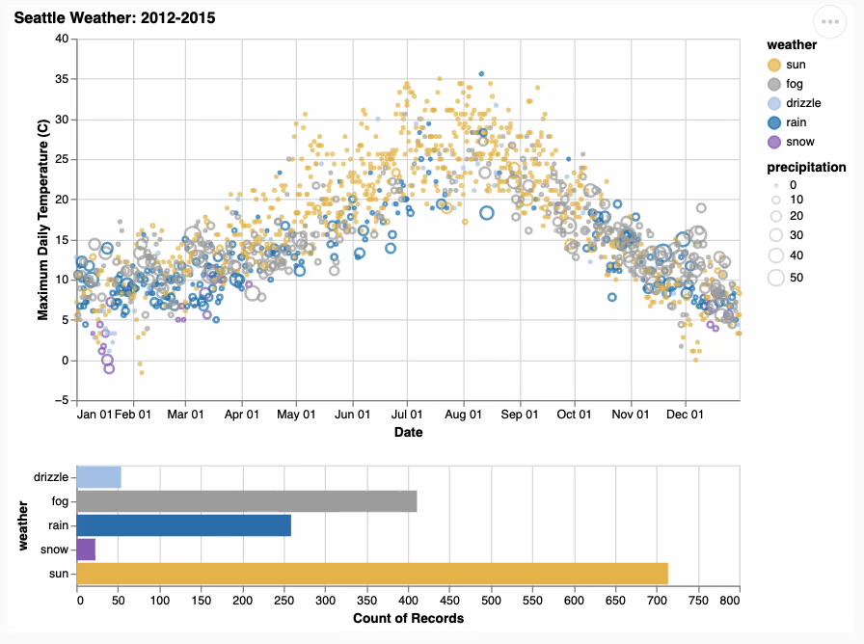
Faceting
Coordinate → Overview/Detail
https://altair-viz.github.io/gallery/seattle_weather_interactive.html
Notes:
On the other hand, if our faces share some data, meaning one shows a subset of the other, then it makes sense for them to either have the same or different encodings.
If they have the same encoding, we call the visualization and overview / detail visualization. If they have different encodings we call the visualization an multiform and overview / detail visualization.
<next>

Slide 18
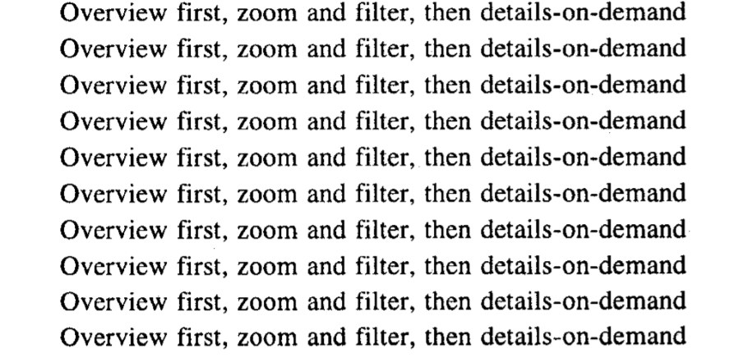
Overview/Detail
- Ben Shneiderman
Shneiderman, 1996
Notes:
Now, hopefully the term overview/detail rings some bells from earlier in the semester when we talked about design rules of thumb.
<next>

Slide 19
Overview/Detail
These are Focus + Context Designs. We’ll talk more about this approach in future lectures.
- Ben Shneiderman
Shneiderman, 1996
Notes:
This kind of a design is called focus + context, and we’re actually going to cover it in depth in a different lecture.

Slide 20
Faceting
Coordinate → Small Multiples
Notes:
Last but not least, if our faceted views share no data (they each show a different subset of the data), then they must also use the same encoding to be considered coordinated. If they used different encodings, then there wouldn’t be any link between the two visualizations.
We call visualizations like this small multiple visualization.

Slide 21
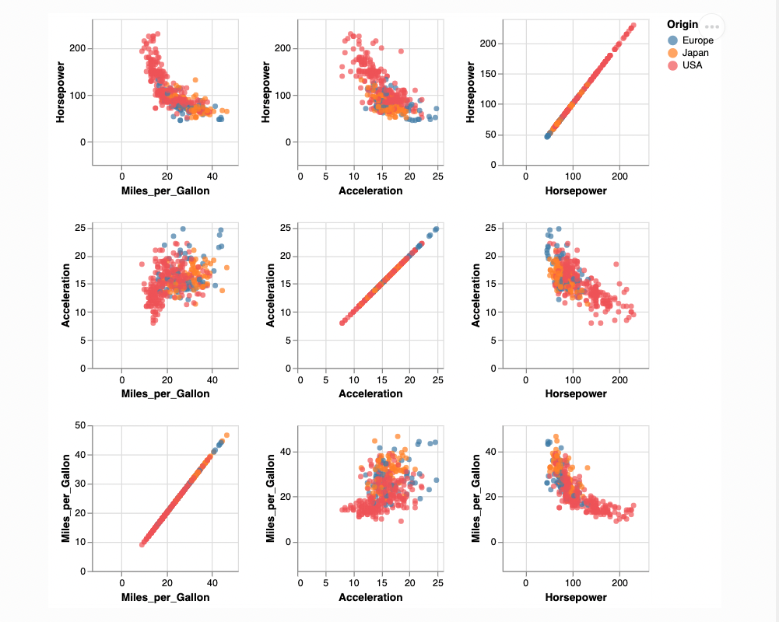
Faceting
Coordinate → Small Multiples
https://altair-viz.github.io/gallery/scatter_matrix.html
Notes:
Last but not least, if our faceted views share no data (they each show a different subset of the data), then they must also use the same encoding to be considered coordinated. If they used different encodings, then there wouldn’t be any link between the two visualizations.
We call visualizations like this small multiple visualization.

Slide 22
Faceting
Coordinate → Linked Highlighting
Notes:
Regardless of which type of visualization we’re talking about, coordinated views implement something called linked highlighting.
<next>

Slide 23
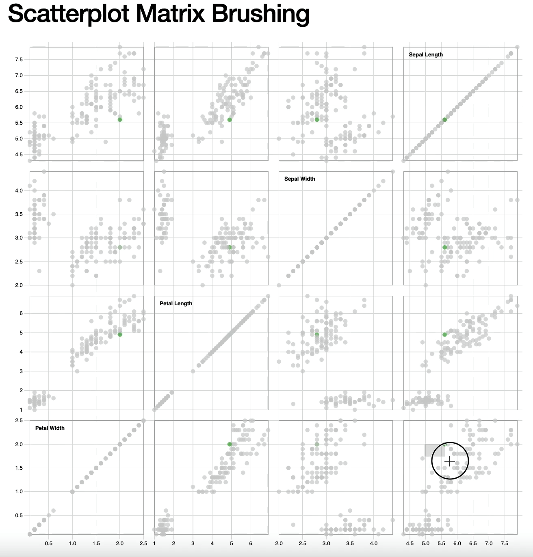
Brushing and Linking
Coordinate → Brushing and Linking
https://bl.ocks.org/mbostock/4063663
Notes:
Here’s an example of brushing and linking on small multiples.
<next>

Slide 24
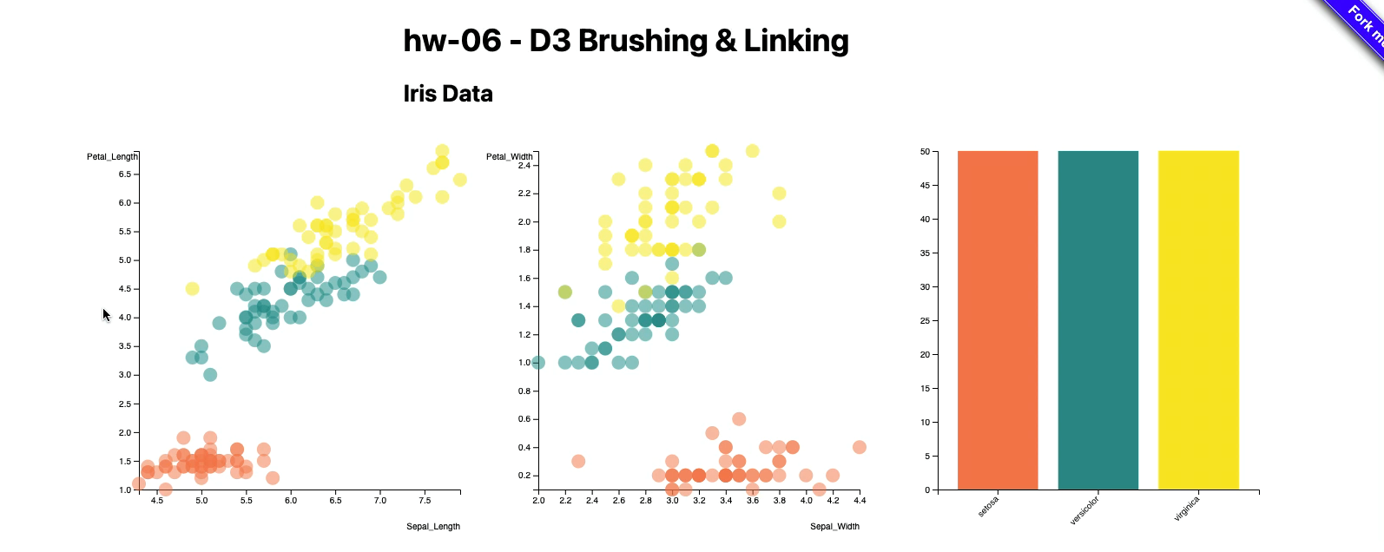
Brushing and Linking
Coordinate → Brushing and Linking
Notes:
And here’s an example in a multiform visualization.
This is what you’ll be working on in your homework this week.

Slide 25
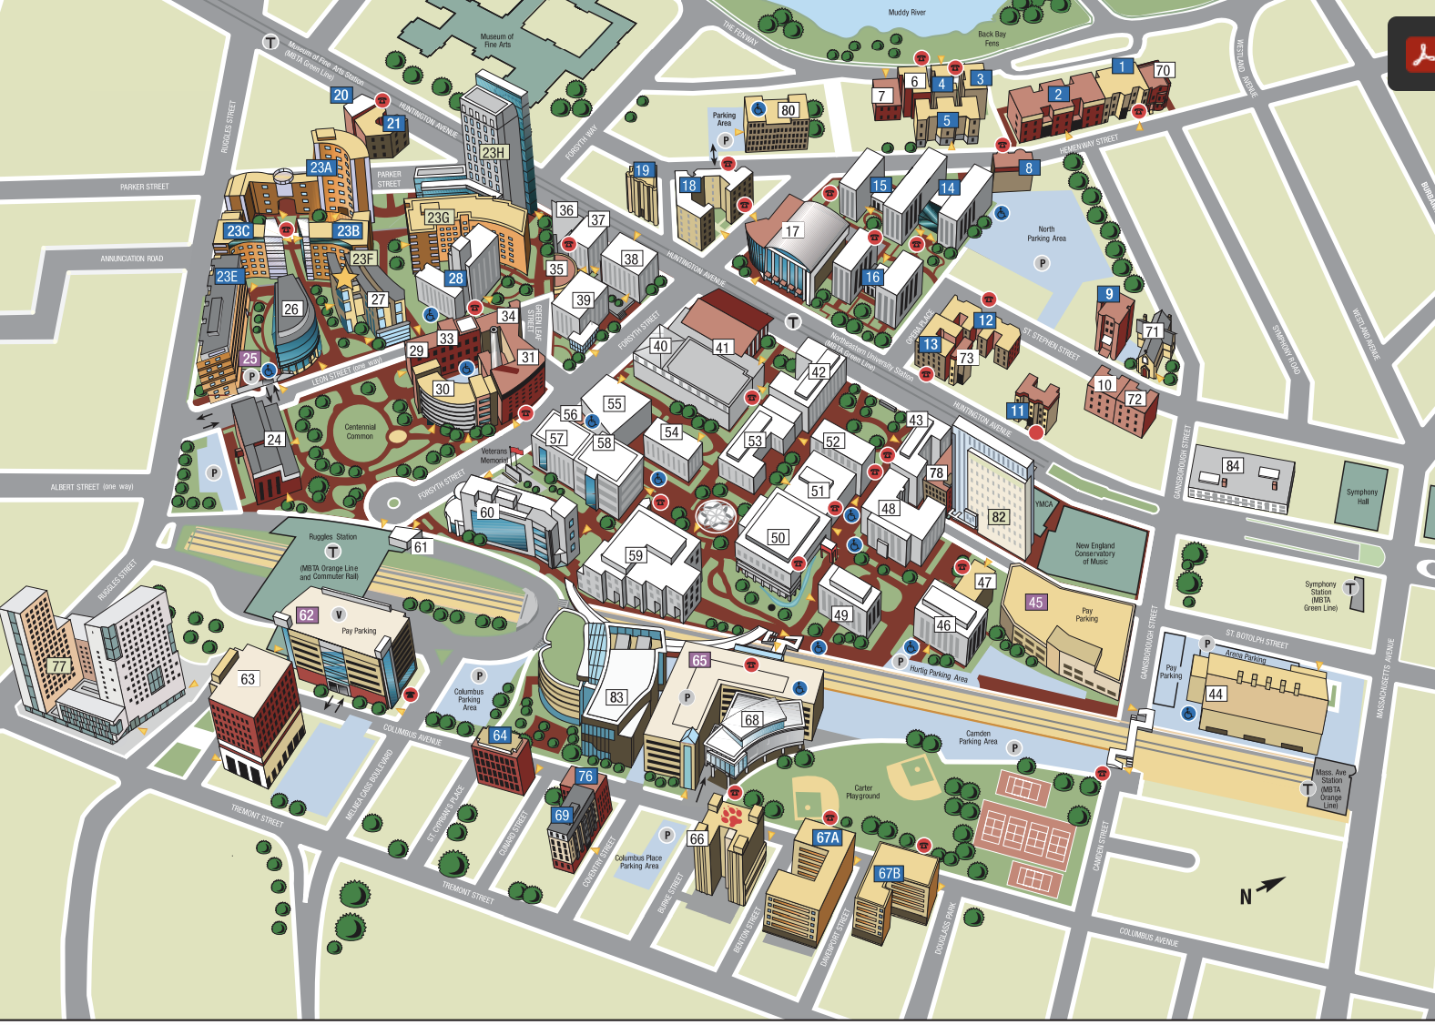
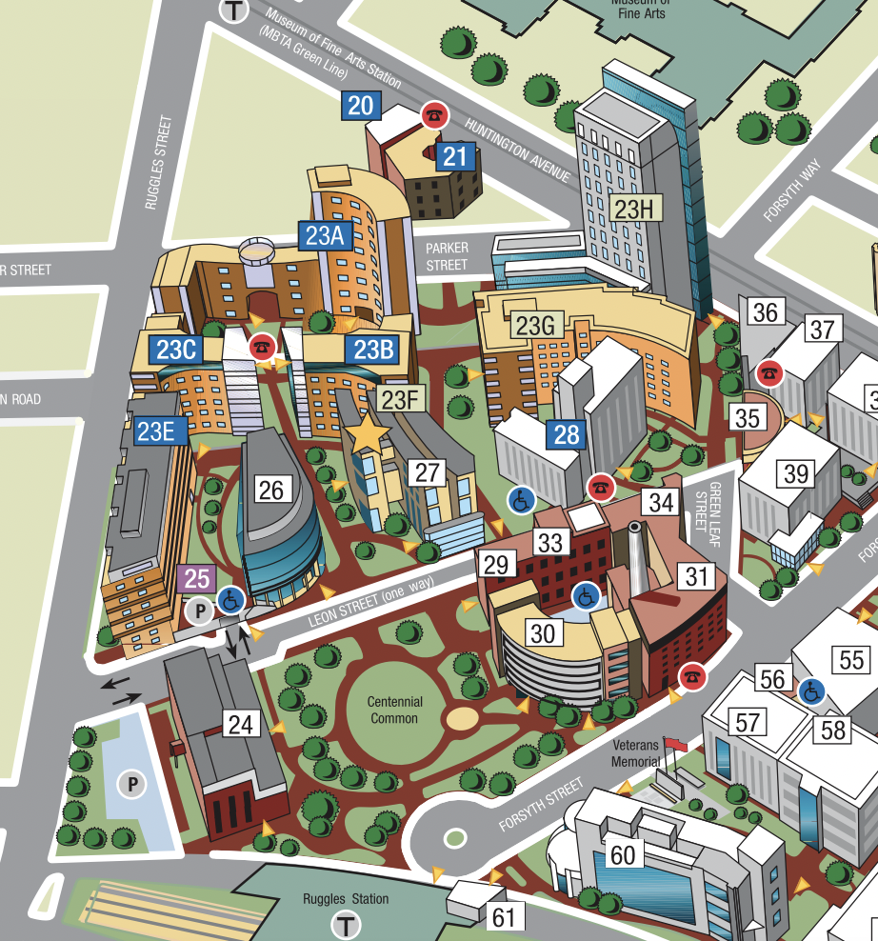

Navigation
Coordinate
Notes:
The last thing I want to touch on for coordinated views is shared navigation. This is another way to coordinate facets.
The idea here is that if you navigate in one view the other views update similarly.

Slide 26
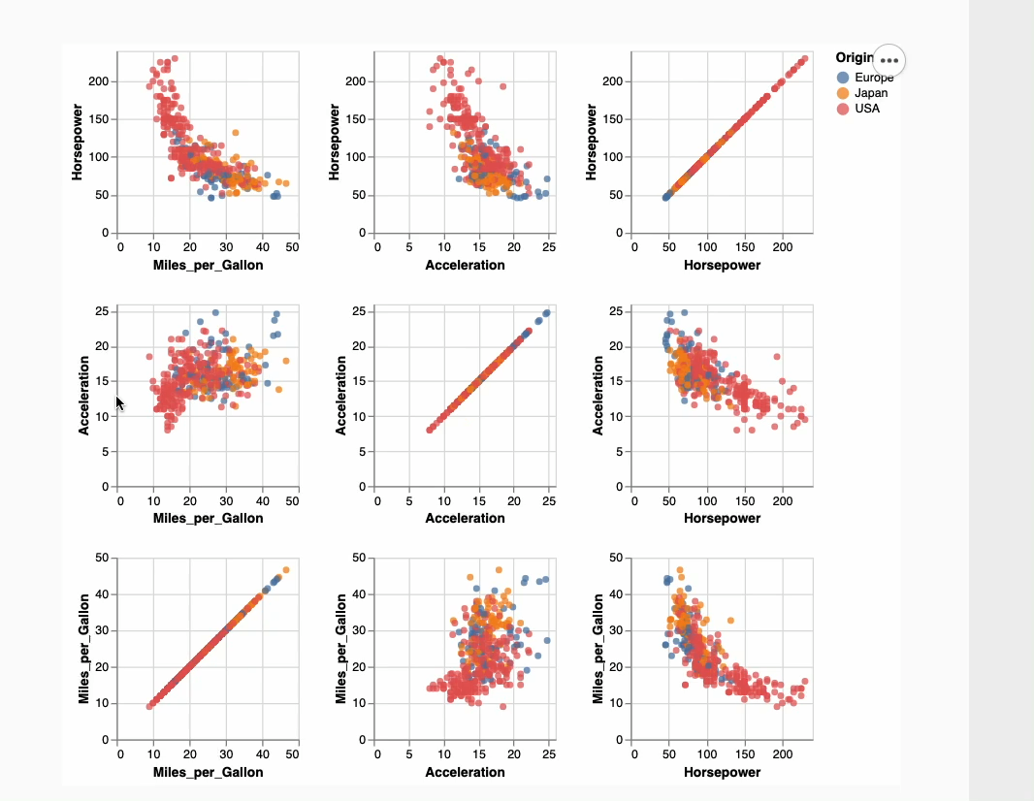
Navigation
Coordinate
https://altair-viz.github.io/gallery/scatter_matrix.html
Notes:
The last thing I want to touch on for coordinated views is shared navigation. This is another way to coordinate facets.
The idea here is that if you navigate in one view the other views update similarly.

Slide 27
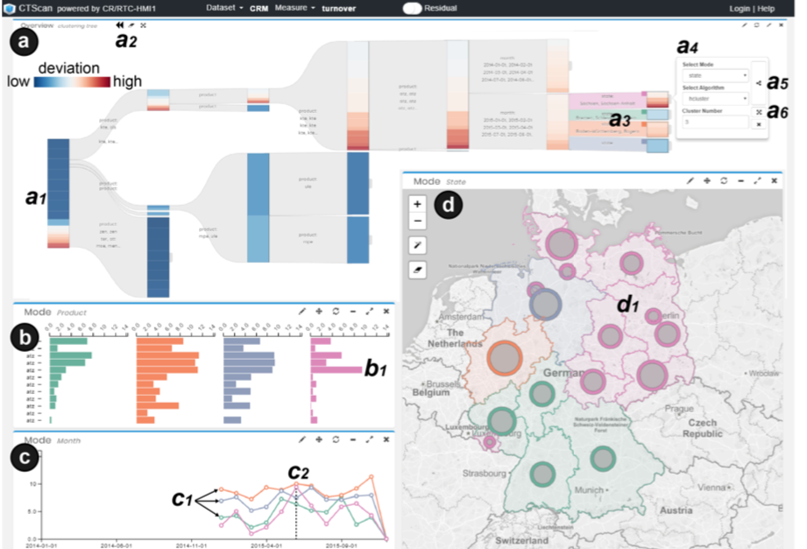
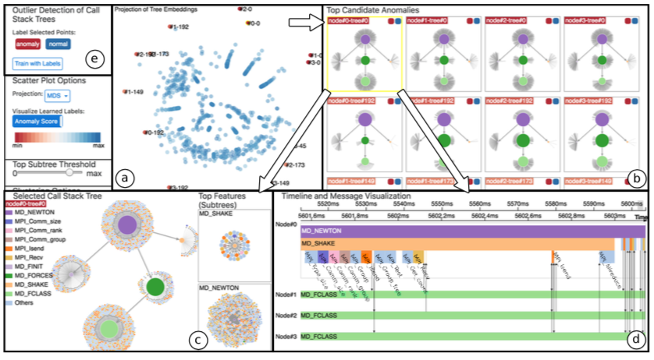
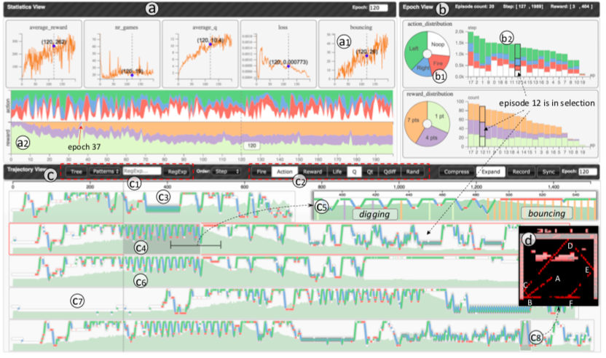
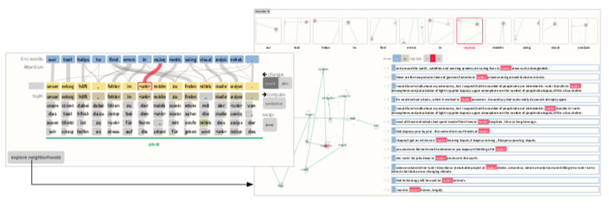
Caveats
Xie et al 2018
Liu et al 2018
Wang et al 2018
Strobelt and Gehrmann et al 2018
Notes:
The very last point I want to touch on is a caveat – which is that coordinated multiple view systems are often unintuitive and difficult to use. They can be really effective tools for visualizing large datasets, but you need to know your audience and plan accordingly.

Slide 28
Let’s take a break! Stretch, go for a walk, be social ☺ Be back here in 10 mins.

Slide 29
Summary
Today we:
Reviewed Interaction
Reviewed Faceting
ic-10 is DUE today.
pm-02 is OUT today.

